Slide 1
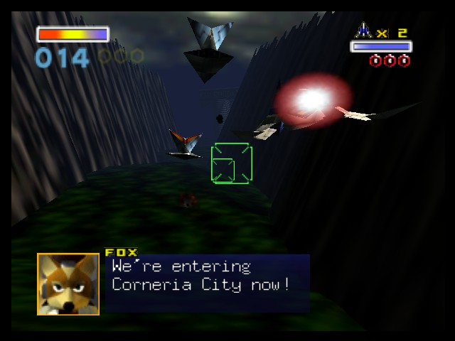
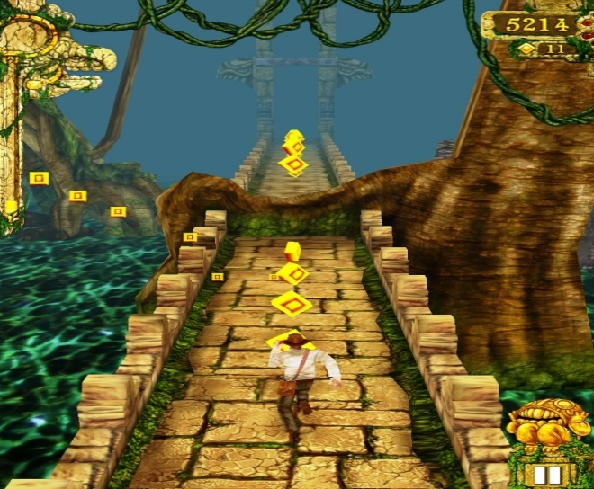
Death-rone
Image from: http://tinyurl.com/qf7gh5j
Image from: http://tinyurl.com/obn3tjs
Notes:
Here, I give a quick introduction about my name, and proceed to inform the potential investors about my game, Death-rone (Death Run/De-throne)

Slide 2
Why Create this?
Gameplay that is fast and fluid.
Simple to play with one hand.
Action combat mechanics.
Notes:
I explain briefly about how I wish to create a game that is easy to play with one hand, feels fast and fluid and has linear style progression with combat mechanics.

Slide 3
Target Market?
People who enjoy linear gameplay action.
People who enjoy non-convoluted stories.
Gamers on the go.
Notes:
I would give a brief explanation on the games intended target market. Generally people who enjoy linear gameplay with simple storylines, as well as gamers on the go. I give a quick reasoning behind this, saying that mobile games can achieve compelling storylines, but a major emphasis on addictive gameplay and fun factor works just as well. (reference from http://preview.tinyurl.com/pnwow5s)

Slide 4
So what’s so different?
Simple control scheme.
Levels progress on-rail style, with end boss battle.
Players choose different levels/bosses to fight, similar to Megaman games.

Slide 5
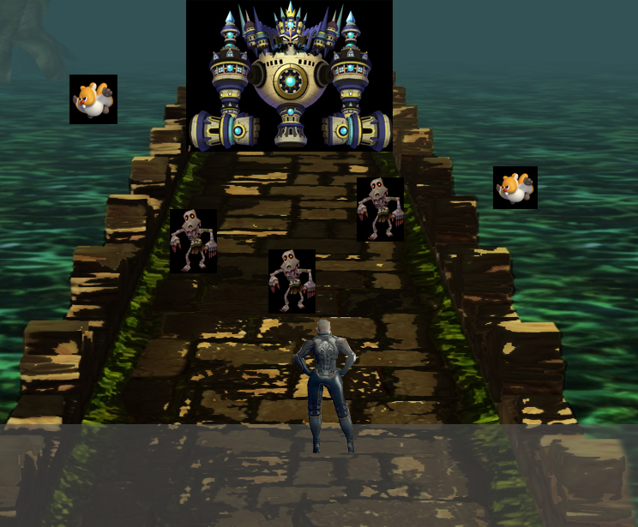
Concept Art
Final Boss of the stage
Combination of flying and ground enemies
Player swipes area to cut, or tap to fire projectile, destroying the enemies.
Grey Area: Player movement Area (left/right/jump)
Player has 3 lives, life count determined by current player character’s aesthetics.

Slide 6
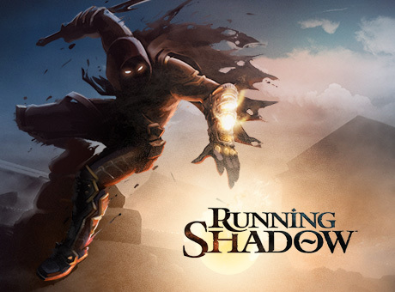
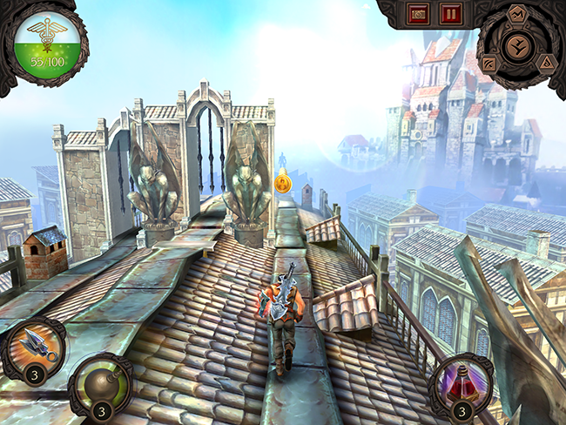
Potential competition?
Running Shadow
On iOS, Android and Steam.
RPG-element.

Slide 7
Why back it?
Emphasis on simple storyline, simple gameplay.
No advantageous benefits via monetary payments.
Game that anyone can enjoy.
Gameplay would not be annoyingly repetitive, losing customer interests.

Slide 8
How much to invest in?
£ 8000, for the first 4 levels. Done in 5 months time.
Include DLC for cosmetics in the future. Price ranging from £ 0.60 to £ 1.50
Charge £1.99

Slide 9
Appendix
http://androidspin.com/2014/02/06/game-insight-releases-details-upcoming-running-shadow-game/ - Running Shadow

